Slide 1
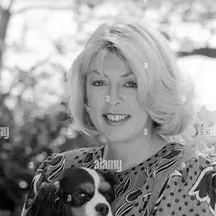
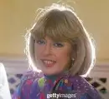
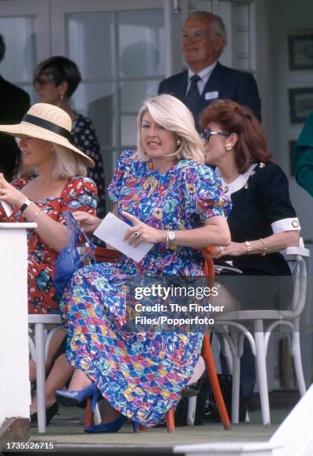
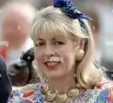
Kanga collection
The true legacy of Lady Dale Tryon
Lin Zainab A true fan of Queen Dale and Queen Camilla

Slide 2
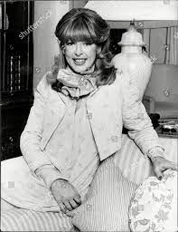
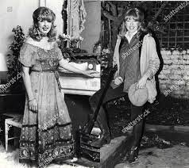

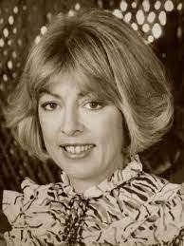
Early years of Kanga
Kanga
What is spina bifida
Rivalry
Who was she?
Kanga’s illness from childhood to adulthood
Kanga and Camilla
Dale Elizabeth Harper was born on the 3rd of January 1948, in Melbourne, Australia she was born with spina Bifida which is an illness affected from birth during the mothers pregnancy, where according to the NHS.UK Spina bifida is when a baby's spine and spinal cord does not develop properly in the womb, causing a gap in the
Spina bifida is a type of neural tube defect. The neural tube is the structure that eventually develops into the baby's brain and spinal cord.
The neural tube starts to form in early pregnancy and closes about 4 weeks after conception.
In spina bifida, part of the neural tube does not develop or close properly, leading to defects in the spinal cord and bones of the spine (vertebrae).
Kanga on the other hand was a true vivacious, bubbly, funny, bouncy like an adorable and pretty kangaroo which is why her husband lord Anthony Tryon which she affectionately called Ant and he called her Kanga, not the prince of Wales he only followed from his best friend Lord Tryon.
Camilla and her where rivals like Glinda and Elphaba fighting for a prince affection, but in the end they seem to get along. Mutual respect.

Slide 3
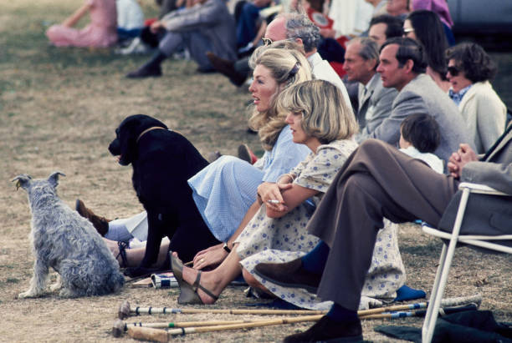
A real-life Glinda + Elphaba
The real reason why I see Dale as Glinda because like Glinda she was popular among the fashion industry, like Glinda she hid her pain behind a smile to make everyone around her smile. Everyone loved and adored her, but she just wanted on true, best friend, which later for Glinda her roommate and rival Elphaba. Sadly, for Dale and Camilla they didn’t have the moment like Glinda and Elphaba in the emerald city and at the wizard of oz palace to make amends and support each other, but like Glinda slowly wears green to show her love and support for Elphaba, maybe the colour blue Queen Camilla wears is not just her favourite colour but to support and to remember her one and only true rival. It would probably make Queen Camilla upset like Glinda when people say no one mourns Dale and talk bad about her one and only true rival.
But deep down I know Dale would also be upset and angry when people balme her ex husband and her only tru rival Camilla for he tragic accident, when she mentioned she was pushed, but deep down she knows it wasn’t Camilla or her husband.

Slide 4
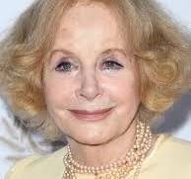
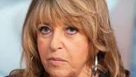
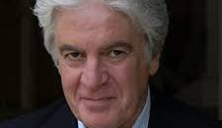
Fake + Toxic friends
These are the fake friends of Kanga Christopher wwilson and eve pollard where journalist after royal gossip, Sarah miles never cared for kanga and never bonded with her children.
If they truly cared for kanga they would do
A documentary calling kanga the fashion queen in the 1980s 1990s, not prince Charles other mistress.
During her time as fashion designer from 1983 . Kanga sadly trusted + confided in journalist who she thought where her true friends, but they were only after royal connections, and when she was excluded from royal events, they no longer wanted to be her friend.
They surrounded her when she mentioned she was pushed when she stayed at farm clinic rehab in surrey, London, then the actress Sarah miles said in the 2003 documentary she got a call kanga had fallen from a high window it was probably the journalist phoning her. Sarah miles was described by Dale’s own daughter that she was so called friend.
Which is true since Sarah did not care about the true Kanga and kanga collection. She didn’t even bother making friends with Dale’s children and husband and family. Sje comes as someone who controlled Dale just like the journalist-controlled Dale.

Slide 5
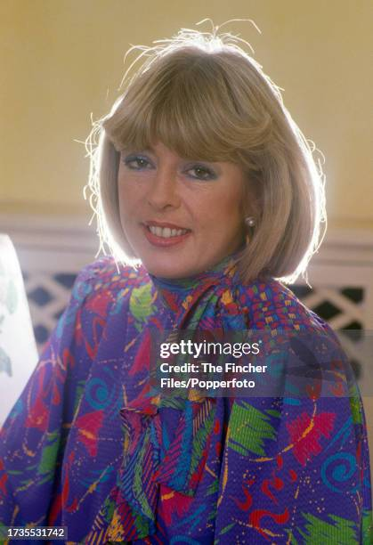
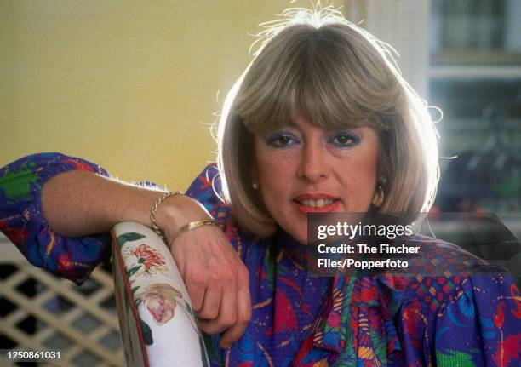
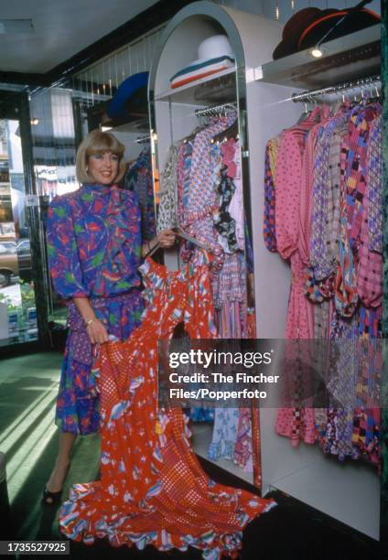
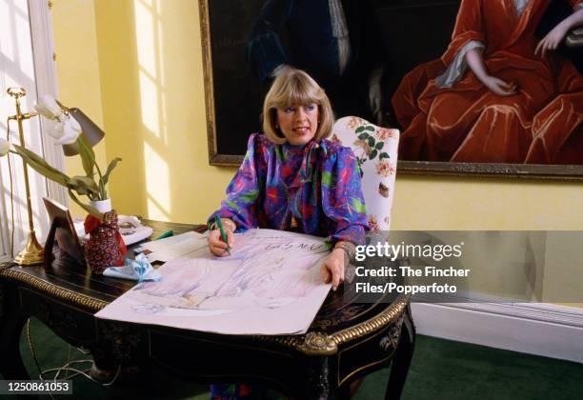
Kanga a true fashion queen
Despite her suffering from spina bifida from childhood and depression which is now know as maniac depression aka bipolar disorder. She forever will be known not as prince Charles other mistress, I mean her opinions mattered to the then prince of Wales the most alongside Camilla parker bowles, which is where their rivalry comes in, but Kanga was indeed a vivacious, funny and vibrant fashion designer and not how many royalist and her so called friends said to get into the spotlight back into the princes life.
Take a look at her designs.

Slide 6
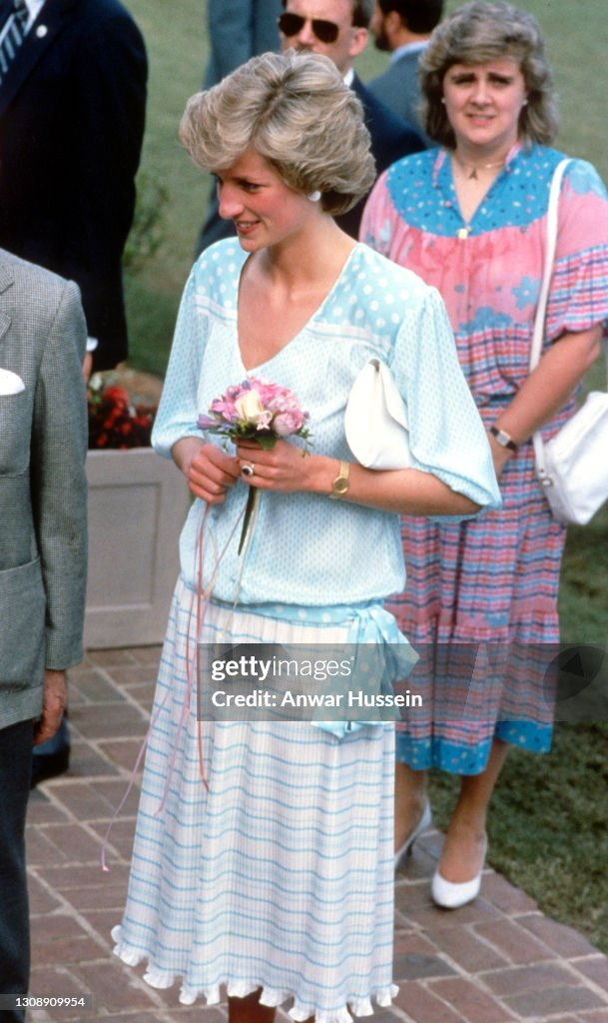
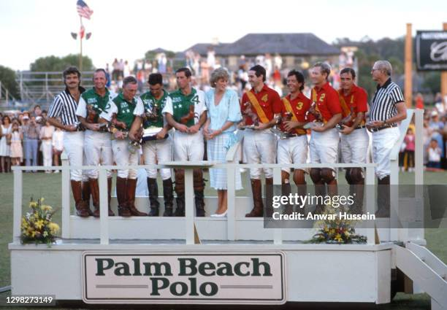
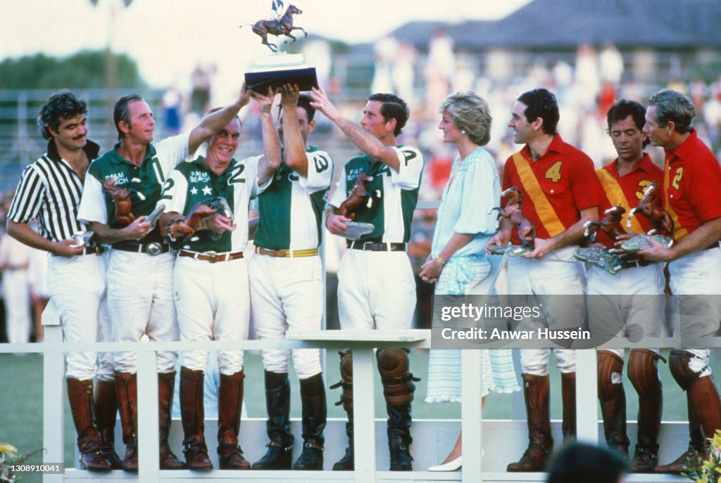
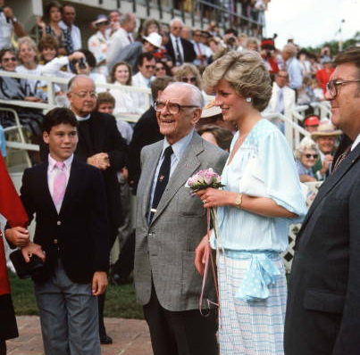
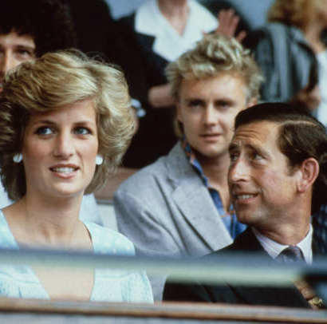
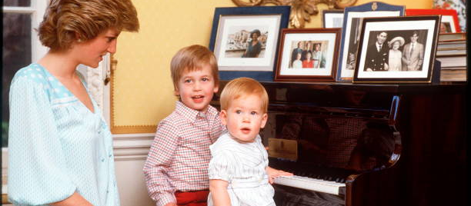
Fashion promotion
Kanga left a message if she could have lunch with the princess of Wales, which they where photographed But little did Knaga know that Diana only ever wore one Kanga dress from her collection to annoy, an make Camilla parker bowles mad.
Diana and her two sons Prince William and Prince Harry
Diana at a polo match wearing a kanga dress
The Wales family interview
Diana and Charles at a live aid concert
Was Diana really a true friend toward Kanga or was it a form of revenge towards Camilla?

Slide 7
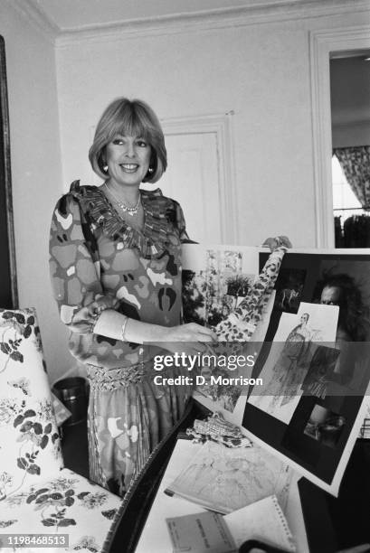
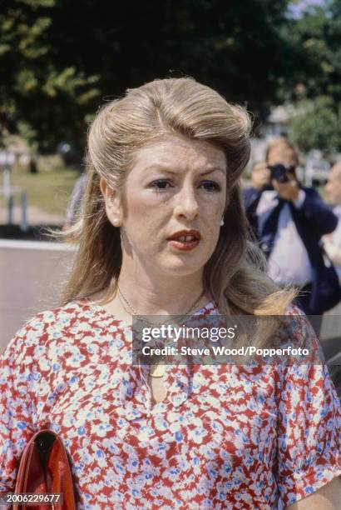
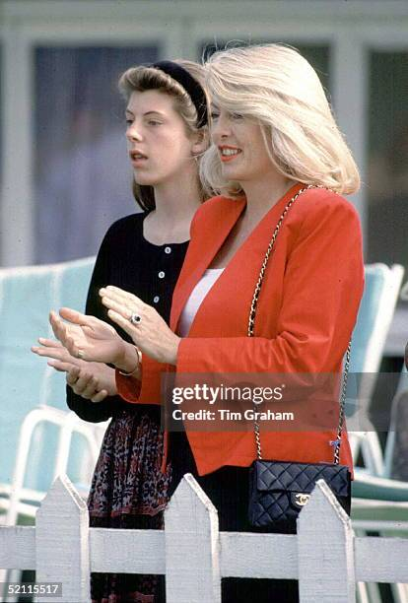
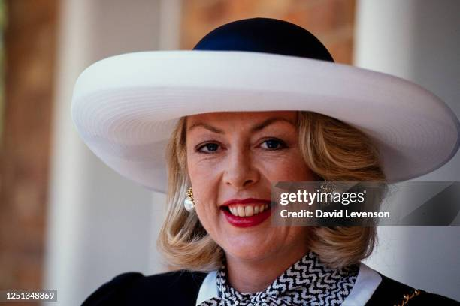



Kanga at royal events
This picture is Kanga at the royal ascot in 1992
Kanga and her eldest daughter Zoe Tryon
March 1985
Here they are at polo match in Windsor in September 22, 1992.
Here she is in her fashion studio showing the fashion journalist her sketches/ designs which turns into beautiful dresses.

Slide 8
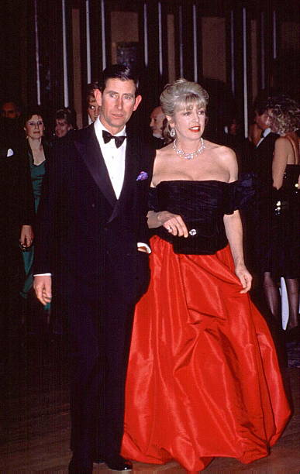
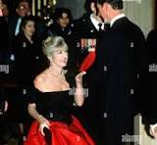
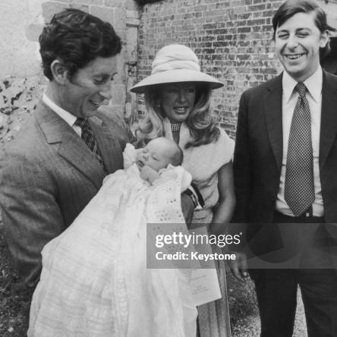
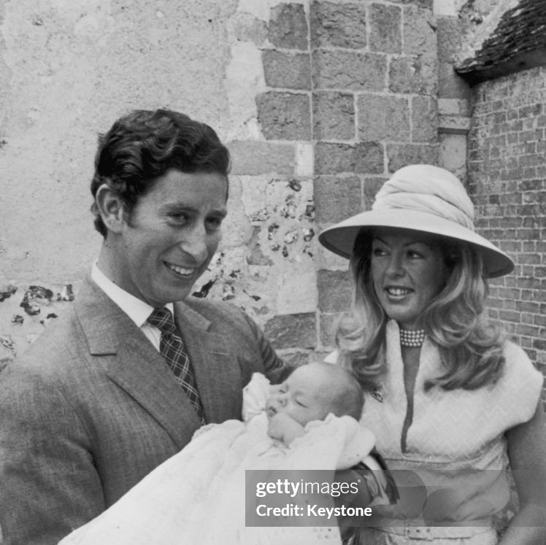
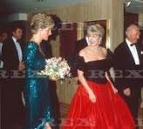
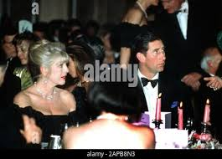
Hier and God child
Did you know since her husband Lord Anthony Tryon was a long term, close/best friend of King Charles 3rd, they made their first son that was born in 1976 Charles tryon a god son to the king, the king is also godfather to his step son Tom Parker Bowles.
At lord and lady Tryons first son’s christening
The king is the God father of her eldest son justas he is also godfather to Tom Parker Bowles
Lady Dale Tryon and her husband with the then prince and princes of Wales at the kanga Ball hosted by Kanga herself in December 1990.

Slide 9
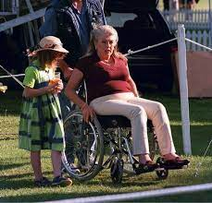
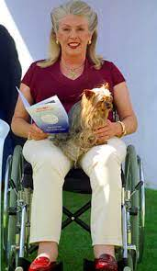
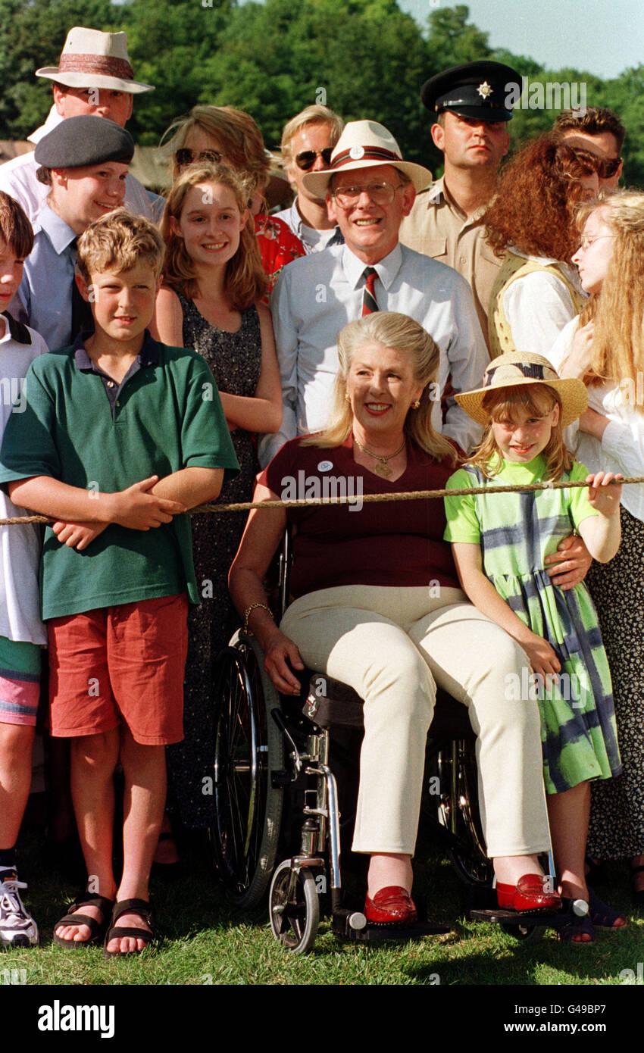
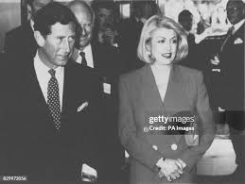
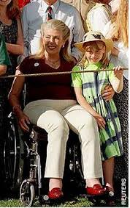
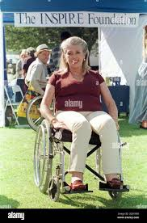
Charitable causes
SANE mental health charity
Inspire
Since she suffered from spina bifida there was charity called inspire that she worked with and even in a wheelchair she looks like a queen.
Lady dale Tryon was also the chairwoman of SANE a mental health charity, with her comforting figure she would comfort anyone with mental illnesses.

Slide 10
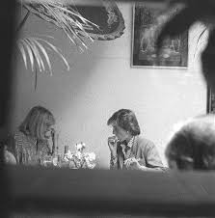
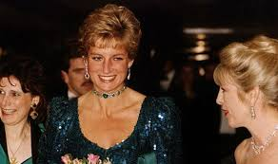
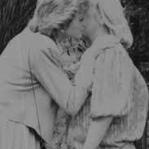
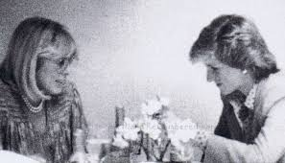
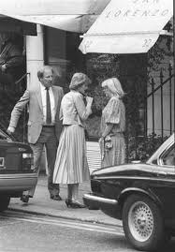
Having lunch with royalty
No evil, villainous plot here but I am jealous I would love to go out for lunch with my faveritoe fashion designer.
Bidding farewell
My moment of jealousy
Kanga ball
Diana and kanga at lunch
Hosted by lady dale tryon also known as kanga for SANE

Slide 11
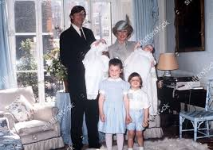
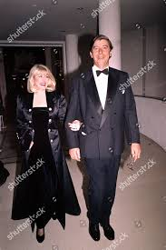
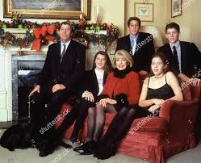
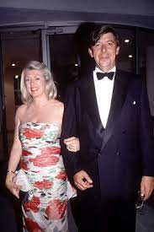
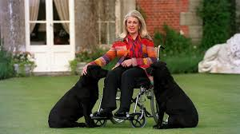
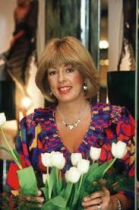
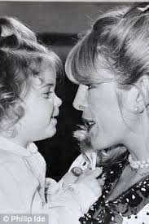

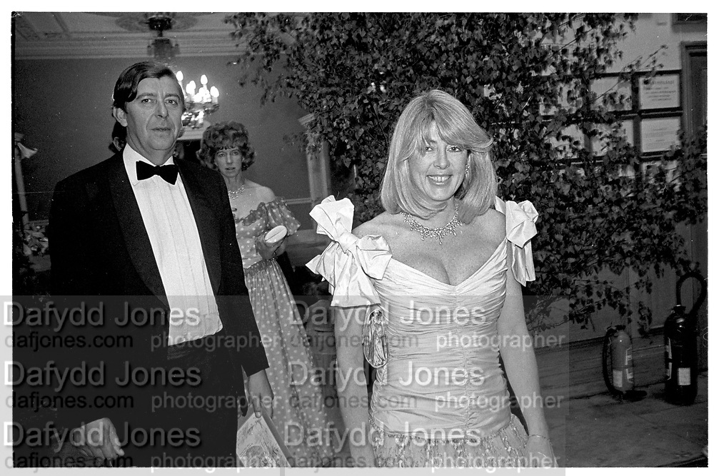




Kanga and family

Slide 12












The kanga collection

Slide 13








Thank you!
Lin zainab
www.fineartschool.net
allan@fineartschool.net
Website:
Email address:
Hop now everyone will remember Kanga’s true legacy as fashion designer and my fashion queen not prince Charles other mistress.

Slide 14










Appendix

