Slide 1
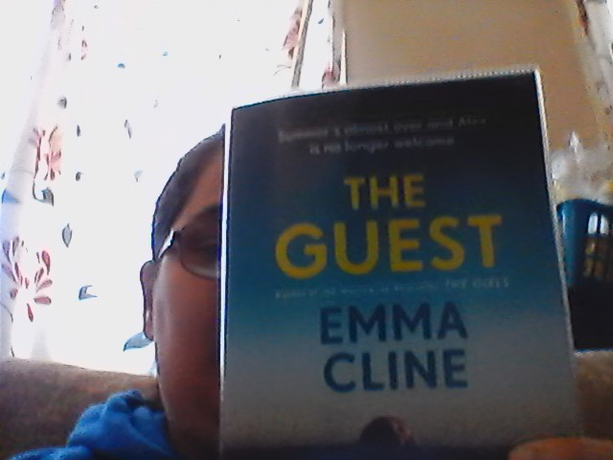
The guest
Emma Cline

Slide 2
Book Blurb
Alex is a young woman teetering on the edge, behind on her rent and with nothing to keep her New York she agrees to spend August by the beach, in the lavish house of the older man she’s been seeing.
After one misstep at a dinner party she’s dismissed with a ride to the station back to the city. But Alex decides to stay on the island, Charming her way into the dazzlingly wealthy set who live there and leaving a trail of destruction behind her. Just how long can she keep going before shes found?

Slide 3
What is the book about?
The guest is a book about a young girl in her twenties living in New York whilst also being behind on her rent. She decides to spend the rest of her summer by the beach by remaining as a guest of a guy she was seeing and few other friends. She also makes out with them but these relationships never last.
The guest is a delicious, dark sided novel – guardian.
Eerily captivating – Elle
Tantalising – New York Times
Compulsivity readable – Independent.
Sultry and engrossing… take it to the beach and savour every page – Observer.

Slide 4
Book review
Cline (2024) has written the guest on a female protagonist point of view of the world but who also is kind of delusional in the environment she is remaining as a guest.
Cline explains to the founder of service 95 Dua Lipa why she did not give Alex a back story of why in order for readers to feel sympathy for the main character. ‘you do end u[ feeling who the character is.’
I quiete enjoyed reading the Guest and seeing from a camera person perspective what Alex sees and does. However, I personally cannot sympathize with Alex since I am more of a person who needs to work in order to get paid and keep track of my rent rather the fall behind on it and staying as a guest. There is no murder involved in this book, the guest, again I am a huge fan of crime novels which is more of clines first book The girls. I still the guest 5 stars same way I gave the girls five stars, just if you’re not a fan of murder or crime novels than the guest is book I recommend for you to read.

Slide 5
Emma clines Reading list
If you want to know more about what inspired Emma Cline to write her book the Guest you can follow service 95 where she shares some interesting books she read and recommends.
https://www.service95.com/emma-clines-recommended-reading-list/

Slide 6


Where to follow the author?
For the full interview Emma Cline and service 95 - https://www.youtube.com/watch?v=pMmcYZ8V4c8
Instagram: @emmanancycline Twitter: @emmahcline Website: https://www.emmacline.com/
https://www.youtube.com/watch?v=8UEPnJWmx88

